Slide 1





Zomato
Analytics
Group 6

Slide 2
Team
Members
Sripada Dilip Kumar
Sanskriti Ankush Watkar
Akash Bakshi
K. Sai Tharun
Koduru Harish Goud
S SHARAN

Slide 3

Agenda
Objectives
Tableau Dashboard
ETL
Power BI Dashboard
KPIs and Insights
SQL Queries
Excel Dashboard

Slide 4
Objectives
Revenue Growth Analysis Track sales trends over time to measure growth and identify peak and low periods, helping to strategize for consistent revenue streams. | Customer Behavior Insights Analyze purchasing patterns to understand customer preferences, order frequency, and spending behavior. | Product Performance Determine which menu items, categories (e.g., fast food, gourmet, etc.), or restaurants perform best and contribute the most to sales.
Market Segmentation Identify key customer segments based on demographics, location, order preferences, or spending habits. | Geographical Insights Looking into sales distribution across different cities or regions can provide insights into regional preferences, helping Zomato focus on growth areas. | Operational Efficiency Analyze delivery times, order fulfillment rates, and customer feedback to improve operational performance.

Slide 5
ETL Process
Extract: Importing Raw Excel File
Transform: Removing Unwanted Records with Null Values
Transform: Creating Required Additional Columns
Load: Loading the Transformed Data into Tableau, Power BI, and MySQL

Slide 6
KPIs
Number of Restaurants, Countries and Cities
Fiscal Year and Monthly sales
Number of Restaurants by Average Rating and Price Bucket List
Count of Restaurants
Count the number of Countries and Cities
Total Votes
We develop a KPI to display sales for each fiscal year, with the fiscal year starting in April.
Visualization depicting quarterly-wise Restaurants open.
Additionally, created a visualization to showcase sales by fiscal month
Number of Restaurants by Average Rating.
Overall Average Rating
Number of Restaurants by Price Bucket List.
Average Cost in USD
Country and City-wise number of restaurants and cuisines.

Slide 7
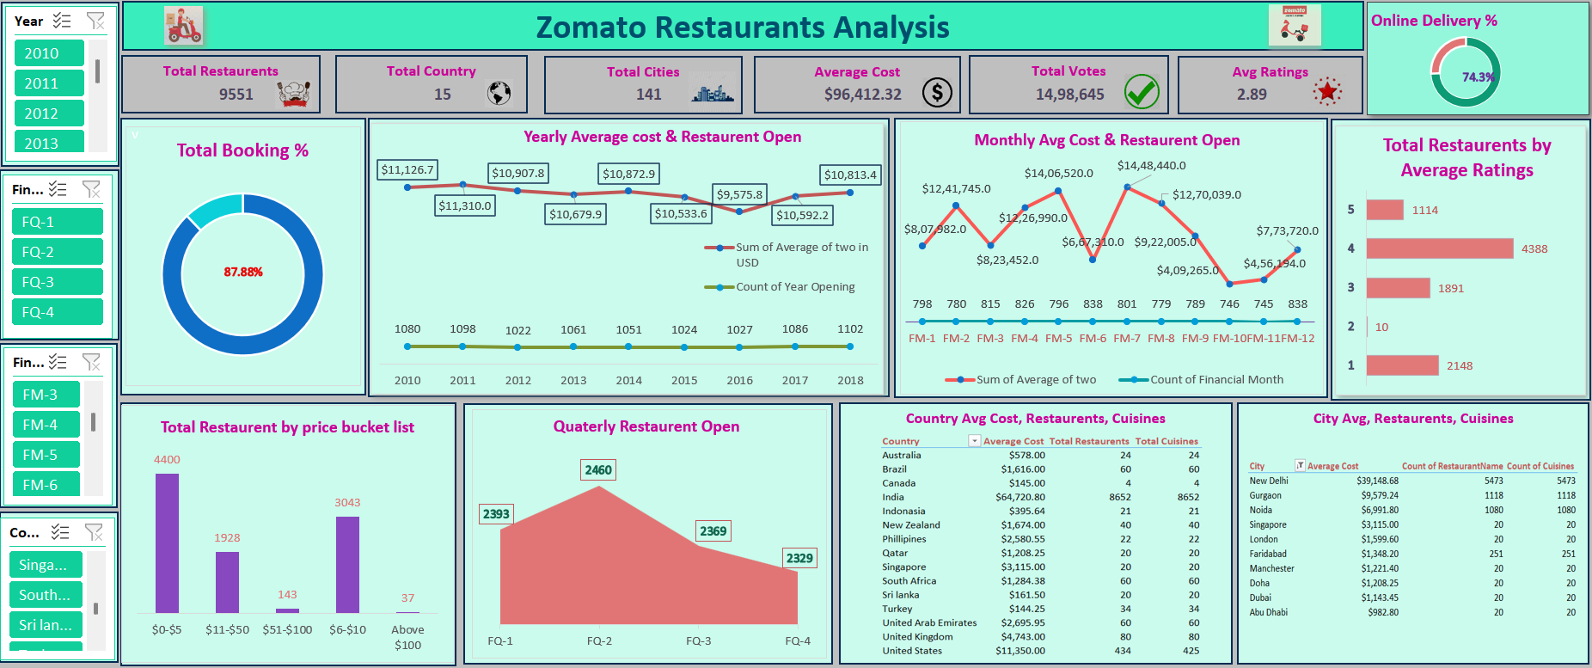
Excel Dashboard

Slide 8
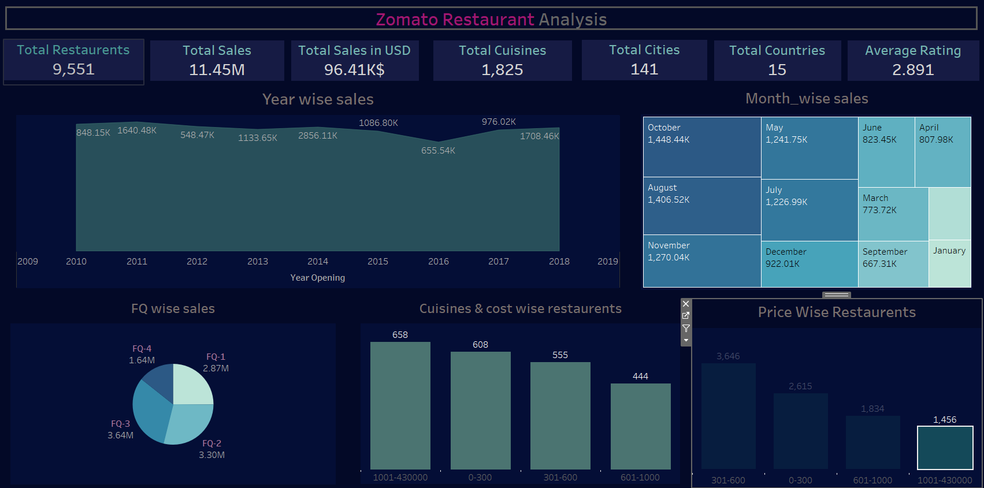
Tableau Dashboard

Slide 9
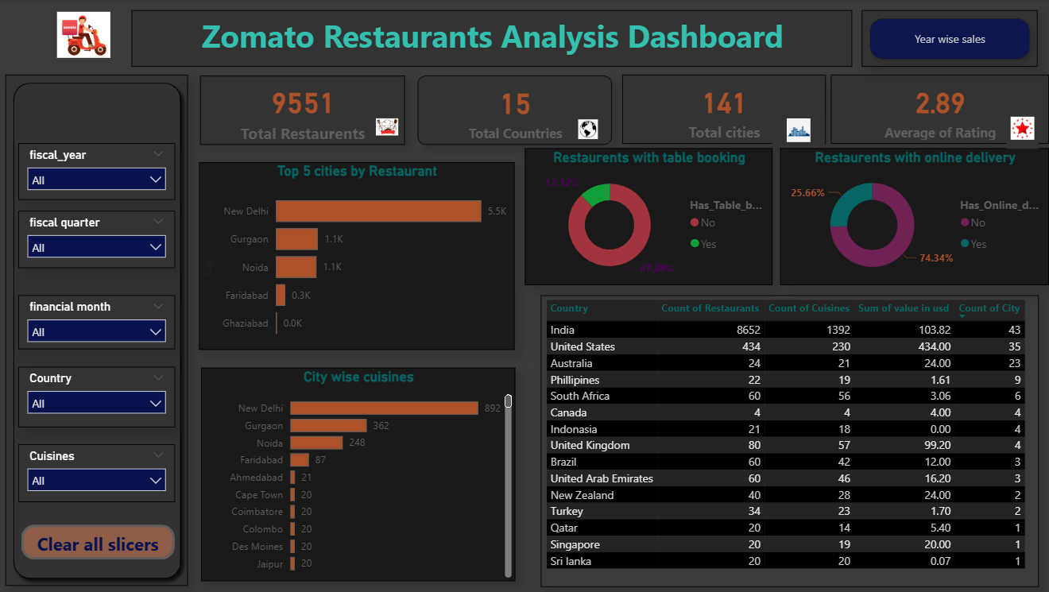
Power BI Dashboard

Slide 10
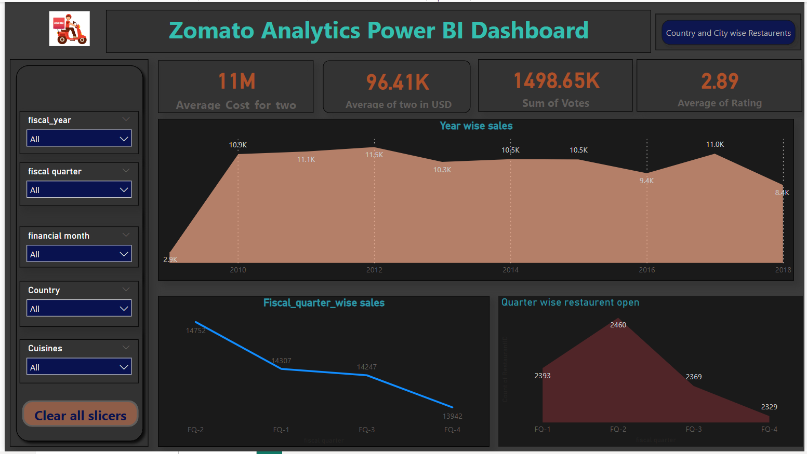
Power BI Dashboard

Slide 11
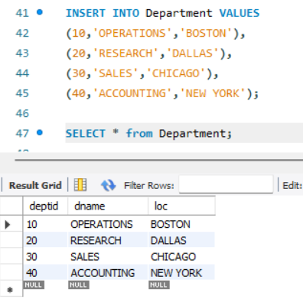
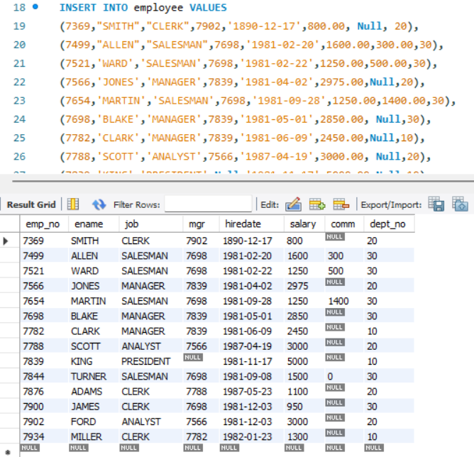
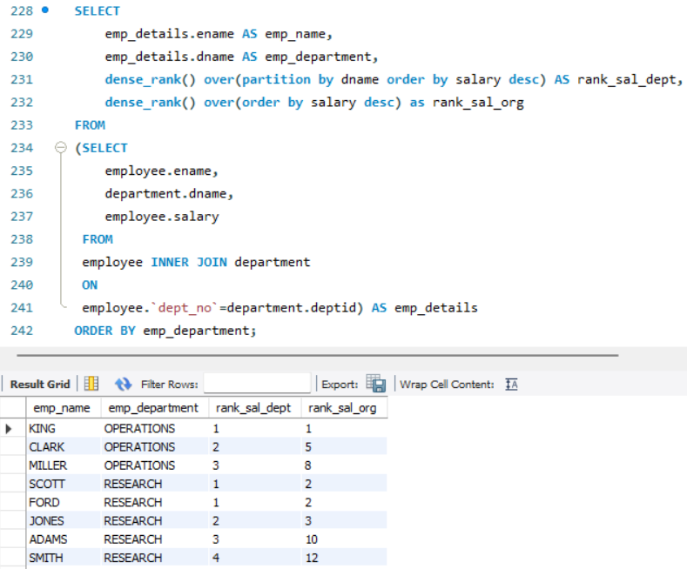
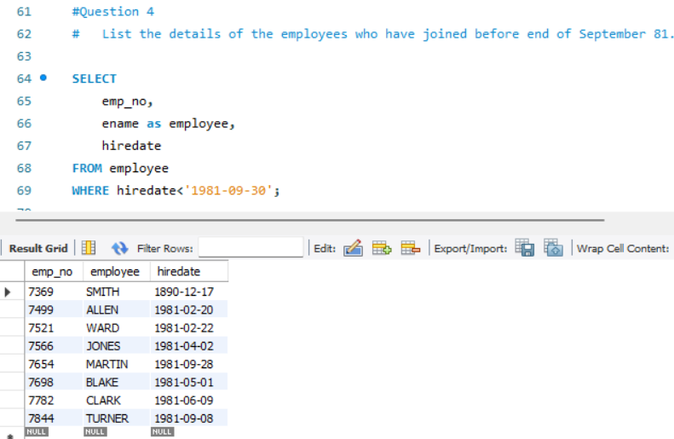
SQL - EMP, DEPT CASE STUDY

Slide 12
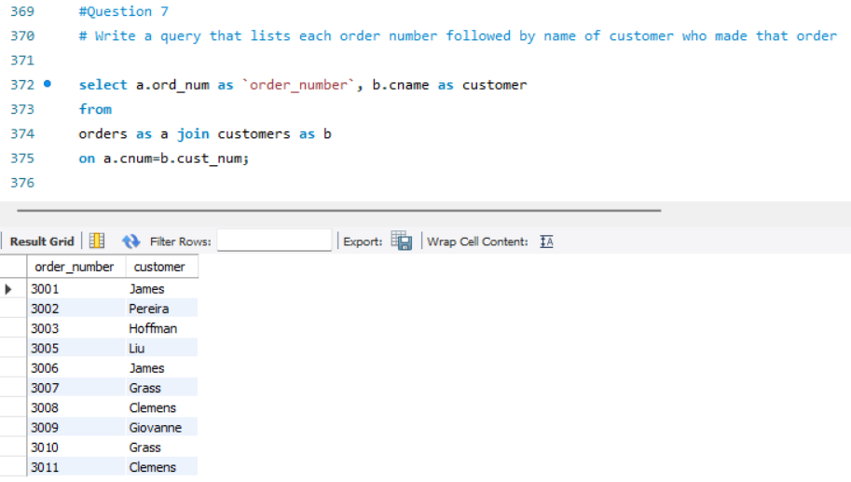
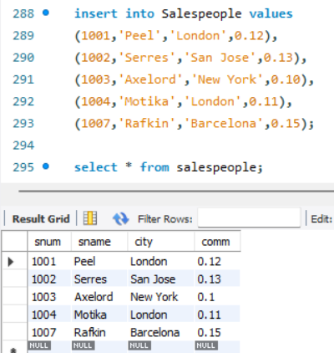
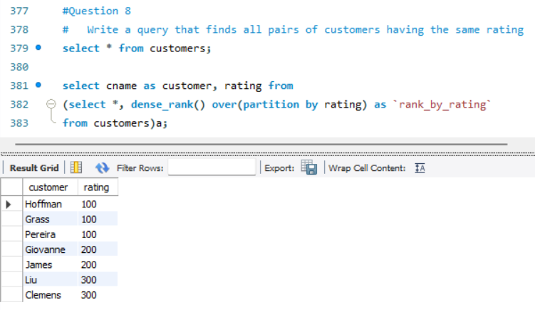
SQL - Orders, Customers and Salespeople

Slide 13



Insights and Observations
The number of restaurants and cuisines in India is high compared to other countries.
The average rating of overall restaurants is 2.89, whereas the average rating of restaurants in India is 2.77
Average sales (in USD) were high in the year 2011.
11.66% of total restaurants have an average rating of 5 and 45.94% have an average rating of 4.
Only 25.66% of restaurants have an online delivery facility and 12.12% of restaurants have the facility of table booking.

Slide 14

Summary
This data analysis focuses on exploring various statistics from Zomato, a popular food delivery and restaurant discovery platform. The primary objectives include understanding customer behavior, restaurant performance, and order patterns.
Key areas of analysis may include:
Customer Insights: Analyzing user demographics, order frequency, average spending, preferred cuisine, and others.
Restaurant Performance: Evaluating restaurants based on user ratings, reviews, average order value, and the number of orders. Comparing high-performing vs low-performing restaurants can reveal factors influencing success, such as cuisine type, location, or service quality.

Slide 15
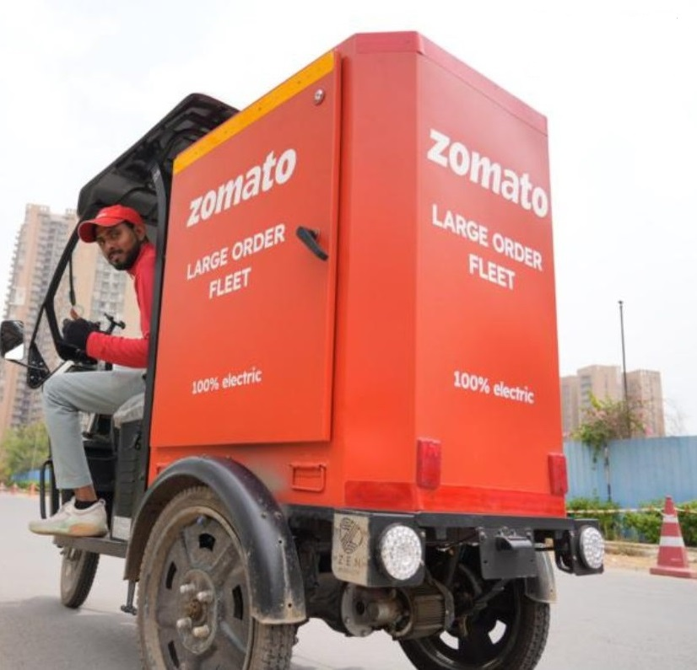
Summary
Order Trends: Identifying popular food items, peak ordering times, and average delivery times. It can also analyze variations in order patterns based on weekdays, weekends, or specific events like holidays.
Customer Feedback: Analyzing ratings, reviews, and complaints to assess customer satisfaction levels. This can help identify common issues like delays, food quality, or customer service problems.
Business Growth Metrics: Evaluating Zomato's growth by tracking new restaurant sign-ups, order volume growth over time, and changes in average order value.

Slide 16

Thank You

